Slide 1
R(T) WO3196 Device 9 and 1
Rijk Hogenbirk
10/04/2020

Slide 2
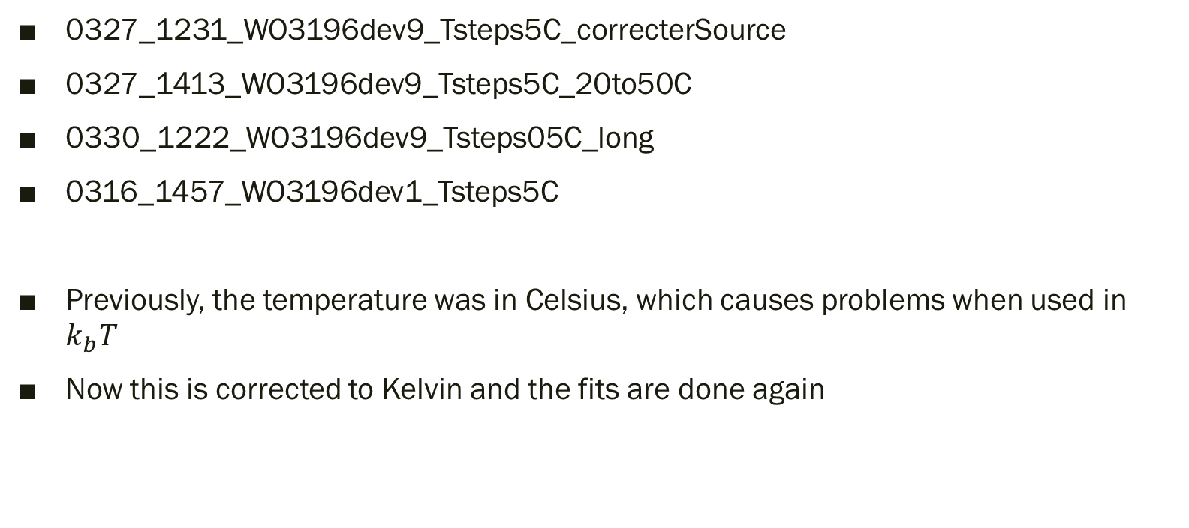
Measurements
0327_1231_WO3196dev9_Tsteps5C_correcterSource
0327_1413_WO3196dev9_Tsteps5C_20to50C
0330_1222_WO3196dev9_Tsteps05C_long
0316_1457_WO3196dev1_Tsteps5C
Previously, the temperature was in Celsius, which causes problems when used in $k_{b}T$
Now this is corrected to Kelvin and the fits are done again

Slide 3
Motivation
Due to the temperature change when new gas is introduced in the chamber with the device, the current hydrogen response and recovery measurements cannot be used to extract the time constants, which is important to evaluate device processes
Therefore the resistance is measured for different temperatures
This can be used to extract the relation between resistance and temperature and with that, use the temperature data to get corrections to the resistance data as if it would be at a constant temperature
Setup
First, the fits are done for device 1 with the Arrhenius equation, both alone and with another resistor in parallel and in serial
Then the best result is applied to the measurements from device 9

Slide 4
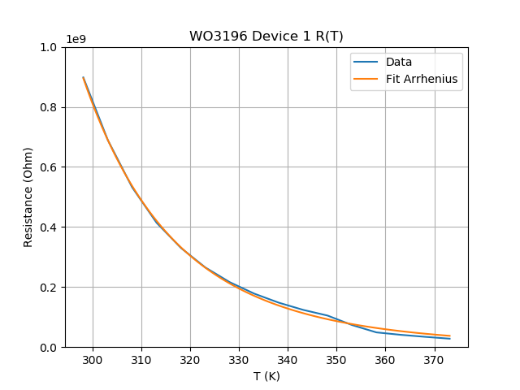


Dev1 25-100C R(T) fits –only R(T)
0316_1457_WO3196dev1_Tsteps5C_RvsT
$$R=A e^{\frac{E_{a}}{k_{b}T}}$$
Variable | Value | Std | Unit
A | 1.25E+02 | 2.31E+01 | Ohm
Ea | 405 | 4.86 | meV
Fit looks good and Ea is in the same range as the value from Giordano
$$R_{300K}=9.98E8 Ω$$
$$ρ_{300K}=4.49 Ωm$$

Slide 5
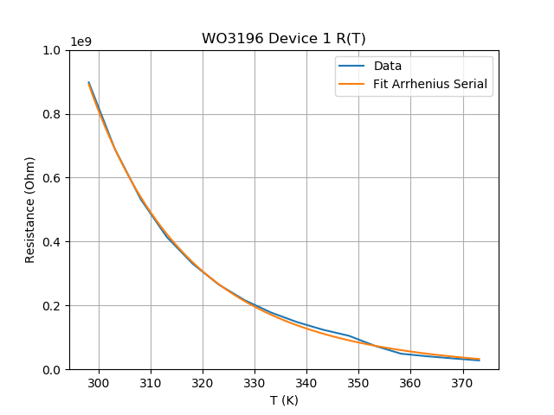
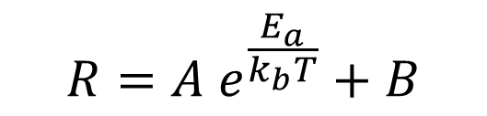
Dev1 25-100C R(T) fits –serial resistance
R(T)
B
0316_1457_WO3196dev1_Tsteps5C_RvsT
$$R=A e^{\frac{E_{a}}{k_{b}T}}+B$$
Variable | Value | Std | Unit
A | 1.39E+07 | 7.71E+01 | Ohm
Ea | 13.5061 | 9.84 | meV
B | 9.97E+08 | 6.82E+06 | Ohm
B is equivalent to a serial resistance in the system
Its value of 1E9 Ohm seems reasonable for what is measured in resistance in total

Slide 6
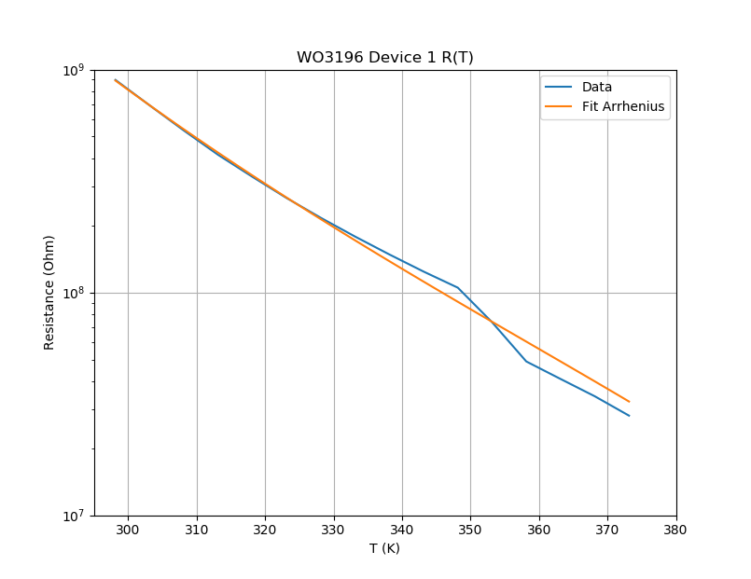
Dev1 25-100C R(T) fits –serial resistance log
R(T)
B
0316_1457_WO3196dev1_Tsteps5C_RvsT
$$R=A e^{\frac{E_{a}}{k_{b}T}}+B$$
Variable | Value | Std | Unit
A | 1.39E+07 | 7.71E+01 | Ohm
Ea | 13.5061 | 9.84 | meV
B | 9.97E+08 | 6.82E+06 | Ohm
B is equivalent to a serial resistance in the system
Its value of 1E9 Ohm seems reasonable for what is measured in resistance in total

Slide 7
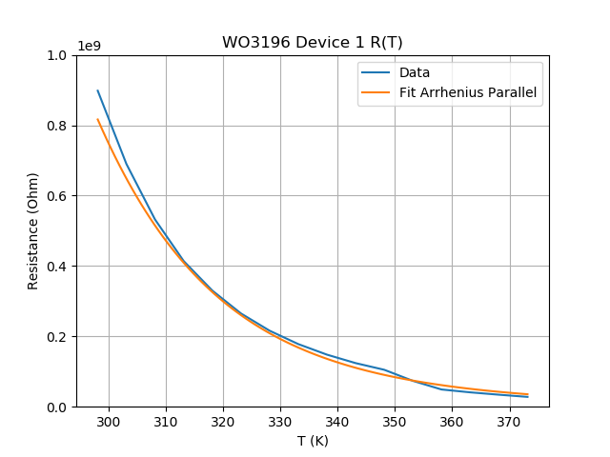
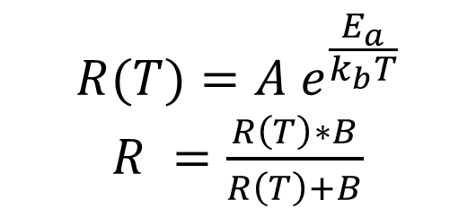
Dev1 25-100C R(T) fits –parallel resistance
0316_1457_WO3196dev1_Tsteps5C_RvsT
R(T)
$$R(T)=A e^{\frac{E_{a}}{k_{b}T}}$$
$R =\frac{R\left(T\right)∗B}{R\left(T\right)+B}$
B
Variable | Value | Std | Unit
A | 6.68E+01 | 1.22E+02 | Ohm
Ea | 424.161 | 5.28E+01 | meV
B | 4.69E+09 | 5.71E+09 | Ohm

Slide 8
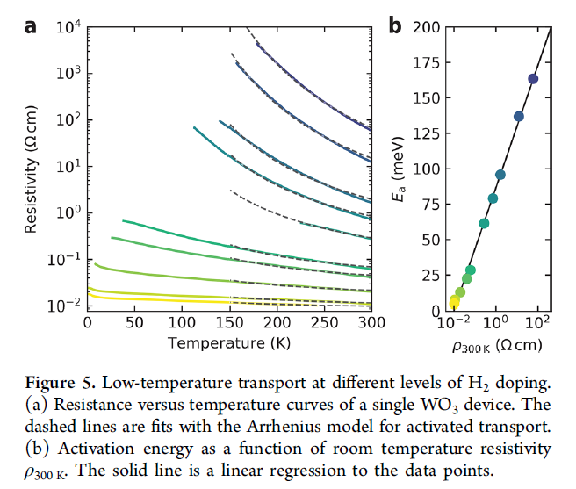
Conclusions – Device 1 different type of fits
Fit with only the temperature dependant resistance already gives good results, i.e. good fit and Ea in the same range as Giordano got without hydrogen (400 vs 175 meV)
The fit with serial resistance gives a low value for Ea (~10 meV). The fit with the parallel resistance gives roughly the same results as the one with only R(T) (similar A and Ea), but has far higher std’s that are higher than the parameter values
Also tried with both an extra serial and an extra parallel resistance, but the fitting function could not handle it, so it did not yield any fits
Questions
Is there a physical interpretation of A in the Arrhenius formula?

Slide 9
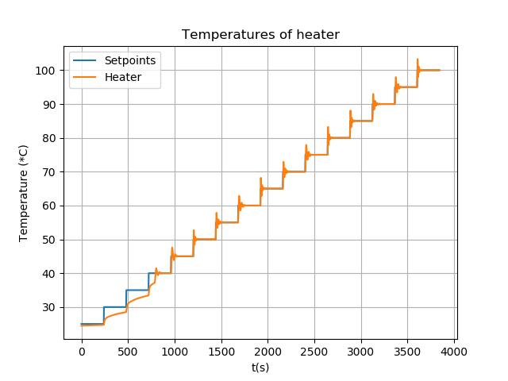
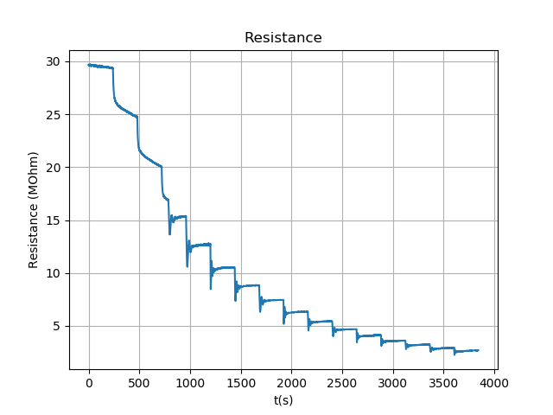
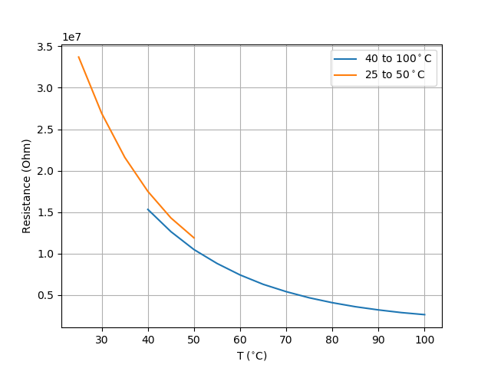
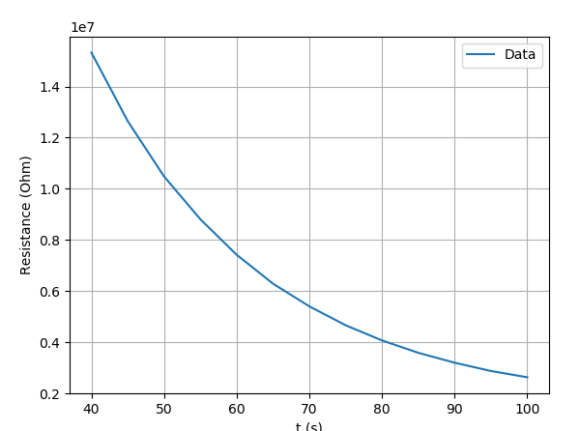
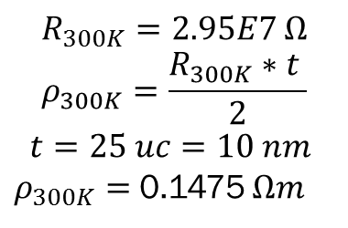
Dev9 - 25 – 100C R(T)
0327_1231_WO3196dev9_Tsteps5C_correcterSource
25-40C measurements not used, due to temperature controller not getting up to the correct temperature
Other measurement done between 20 and 50C, but not useful as resistance drifted in between measurements
$$R_{300K}=2.95E7 Ω$$
$$ρ_{300K}=\frac{R_{300K}∗t }{2}$$
$$t=25 uc=10 nm$$
$ρ_{300K}=$ 0.1475 $Ωm$

Slide 10
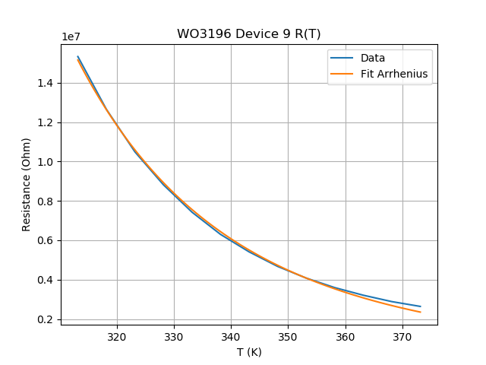
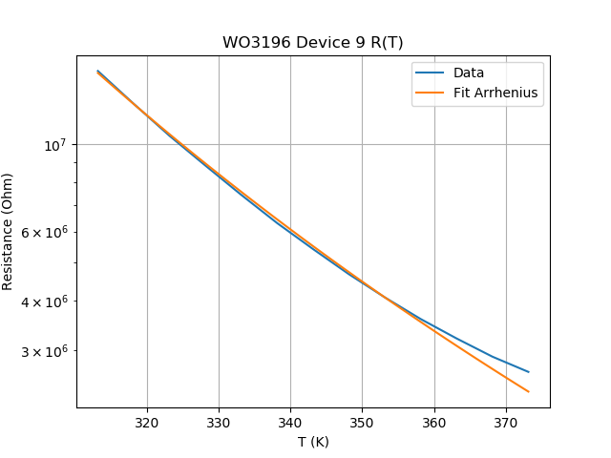
Dev9 40-100C R(T) fits –only R(T)
0327_1231_WO3196dev9_Tsteps5C_RvsT
$$R=A e^{\frac{E_{a}}{k_{b}T}}$$
Variable | Value | Std | Unit
A | 1.42E+02 | 1.94E+01 | Ohm
Ea | 312 | 3.82 | meV
Fit looks good and Ea is in the same range as the value from Giordano

Slide 11
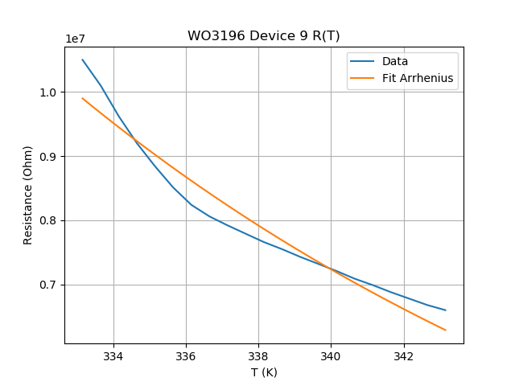
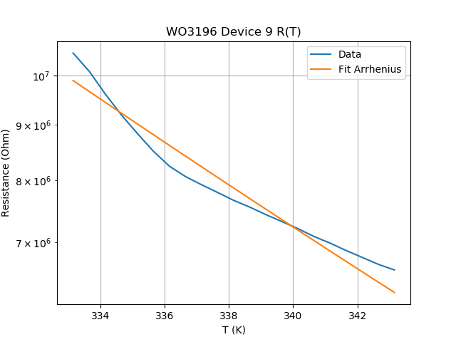
Device 9 60-70C R(T) fits –only R(T)
0330_1222_WO3196dev9_Tsteps05C_long_RvsT
$$R=A e^{\frac{E_{a}}{k_{b}T}}$$
Variable | Value | Std | Unit
A | 1.73E+00 | 1.48E+00 | Ohm
Ea | 447 | 24.9 | meV
Zoomed in version of the 20-100C measurement
Similar values to that measurement, but the fit itself is quite bad

Slide 12
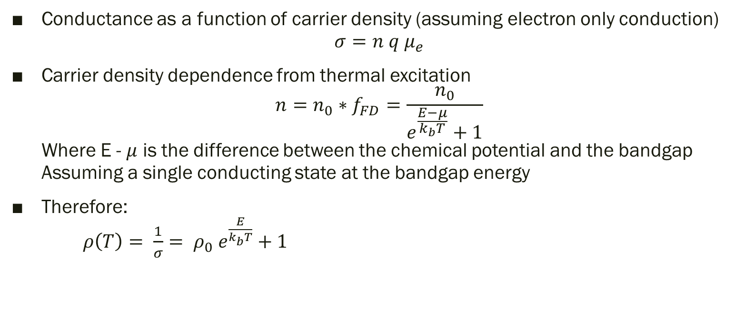
Semiconductor R(T) theory - own
Conductance as a function of carrier density (assuming electron only conduction) $σ=n q μ_{e}$
Carrier density dependence from thermal excitation $n=n_{0}∗f_{FD}=\frac{n_{0}}{e^{\frac{E−μ}{k_{b}T}}+1}$ Where E - $μ$ is the difference between the chemical potential and the bandgap Assuming a single conducting state at the bandgap energy
Therefore: $ρ\left(T\right)= \frac{1}{σ}= ρ_{0} e^{\frac{E}{k_{b}T}}+1$

Slide 13
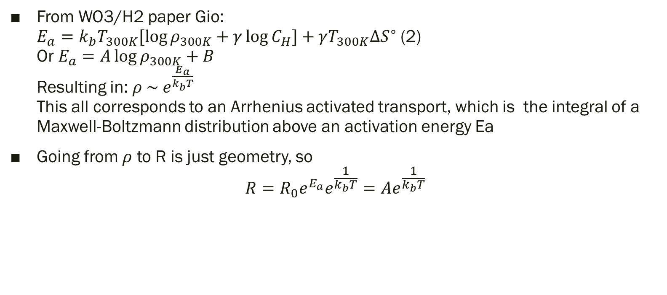
R(T) Theory - Giordano
From WO3/H2 paper Gio: $E_{a}=k_{b}T_{300K}[\log{ρ_{300K}+γ\log{C_{H}}]+γT_{300K}ΔS^{∘}}$ (2) Or $E_{a}=A\log{ρ_{300K}}+B$ Resulting in: $ρ \sim e^{\frac{E_{a}}{k_{b}T}}$ This all corresponds to an Arrhenius activated transport, which is the integral of a Maxwell-Boltzmann distribution above an activation energy Ea
Going from $ρ$ to R is just geometry, so $R=R_{0}e^{E_{a}}e^{\frac{1}{k_{b}T}}=Ae^{\frac{1}{k_{b}T}}$

Slide 14
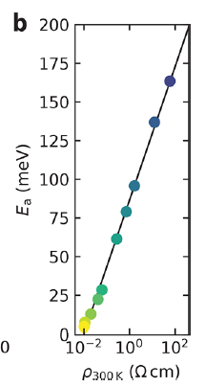

Comparison against data Giordano
Device 1
Device 9
Device 1
$E_{a} =405 meV$
$ρ_{300K}=0.14 Ωm$
Device 9
$E_{a}=312meV$
$ρ_{300K}=4.49 Ωm$

Slide 15
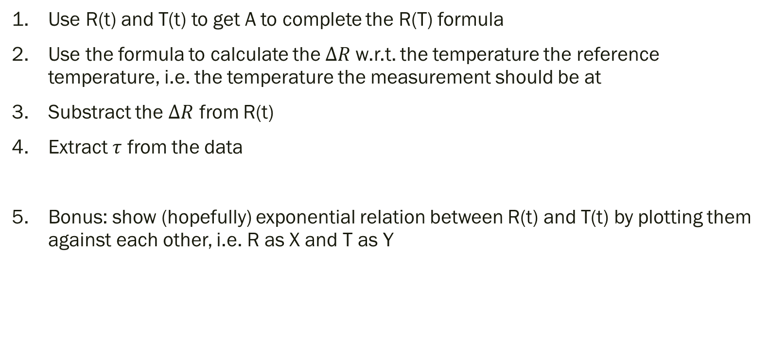
Procedure for temperature correction
Use R(t) and T(t) to get A to complete the R(T) formula
Use the formula to calculate the $ΔR$w.r.t. the temperature the reference temperature, i.e. the temperature the measurement should be at
Substract the $ΔR$ from R(t)
Extract $τ$ from the data
Bonus: show (hopefully) exponential relation between R(t) and T(t) by plotting them against each other, i.e. R as X and T as Y

Slide 16

To Do
Analyse 0316_1457_WO3196dev1_Tsteps5C 25-100C measurement -Done
Extract R(T) from data
Extract $R_{0}$ and $E_{a}$ from R(T)
Use data to correct hydrogen response & recovery measurement

